Slide 1



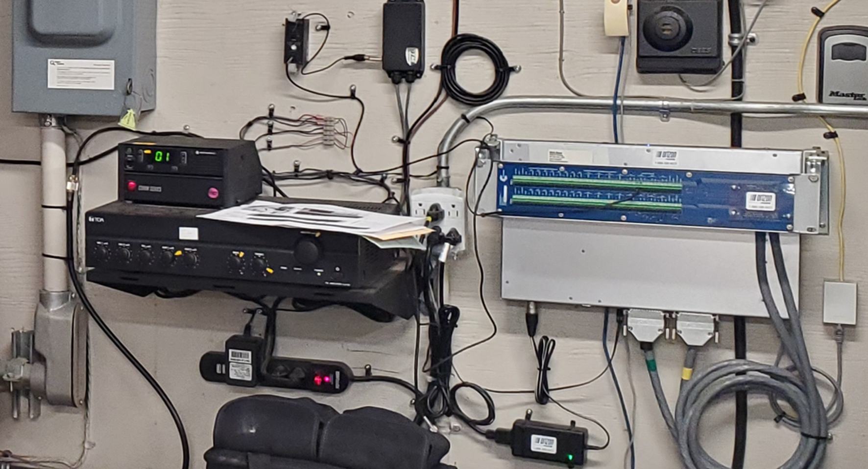

Fire Station Alarm Dissemination
And Electrical Control
The Cortex Series can be used for building automation as well as to send voice notifications for public security and fire stations.
To achieve this goal, we partner with Komutel and their TARGA Interactive Dispatching Alert solution to implement a workflow that transforms information from a 911 call center into audio files and building automation commands. Depending on the requirements, we can also integrate carbon monoxide detectors, open-door sensors, vehicle location detectors, etc. Statistics can also be compiled on response times achieved.
The ultimate goal for this system is to make operations more efficient and improve response times to alarm calls by automating certain functions in the fire stations and by having voice notifications sent to the buildings’ PA systems.
On-site equipment consists of a CORTEX unit at each fire station for building control (ex: turn off oven breakers and activate emergency lights), as well as to play back alarm-dependent audio files on the PA system. One of the stations can be equipped with a radio system (ex: P25) to notify off-site fire chiefs and other personnel.
See http://davicom.com for more details

Slide 2
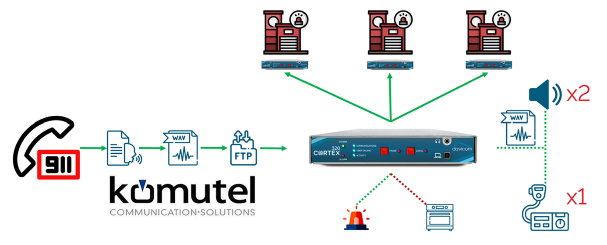
The overall process happens as described below:
An alarm call comes in, and once the dispatcher has finished entering the call information, the 911 system sends the calling card to different groups in TARGA. It has a vocal group and a building automation group for the recommended station.
TARGA does a complete ingest of the information and concatenates everything into the proper order: Recommended station, Nature of call, Time, Address of the incident.
Using a « text to speech » program, TARGA then transforms the data into a .wav file and sends it to the FTP servers of the 3 Cortex units installed in the 3 stations.
Using the SNMP protocol, the TARGA system also sends commands to the CORTEX in order to play the audio and activate the building automation IF the station concerned is recommended to respond to the alarm. A 3-alarm circular buffer allows a second voice message to be played-out if a first one is already playing.
The alarm is played-out once on both the P25 radios as well as on the PA system in the 3 stations. And then a second time but only on the PA systems so that the radio channel is available for urgent communications. As an example, the audio playout could read as follows: STATION 50, Nature of the call: Building fire, Time of call: 2:58 p.m., Address: 120 McCune Road.
The CORTEX unit will also use its internal relays to turn-off oven and stove breakers as well as to turn on emergency lighting. Latch time and other parameters can be easily set in the software.
The figure below shows the overall system block diagram:
The system is very flexible and can be customized to pretty much any building automation requirement. Since the Cortex has extra inputs and outputs available for adding sensors and controlling devices, practically any operating scenario imaginable can be realized.
We at Davicom are always available to help.
See http://davicom.com for more details

